Slide 1
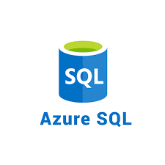

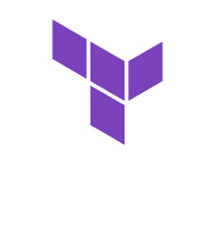
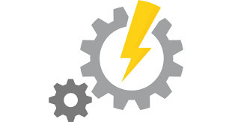
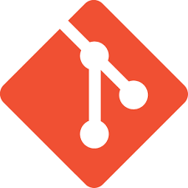
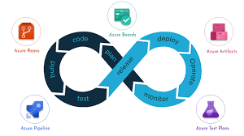
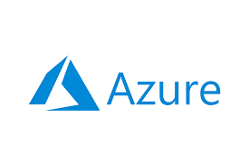
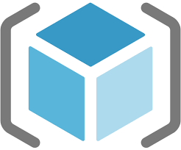
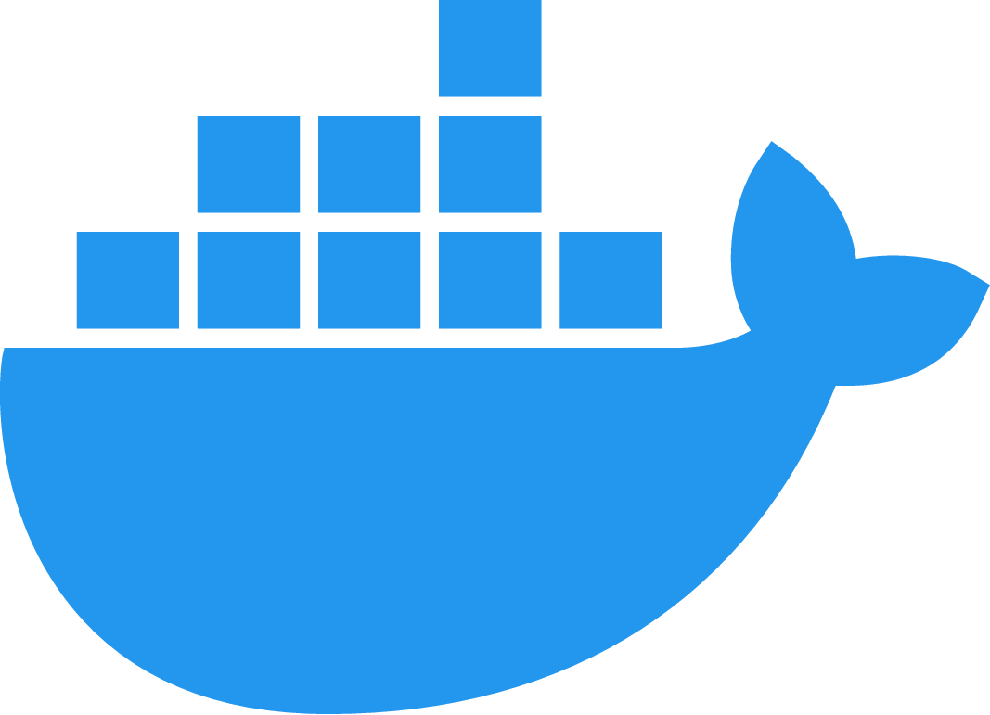

Azure DevOps Services - Detailed

Slide 2
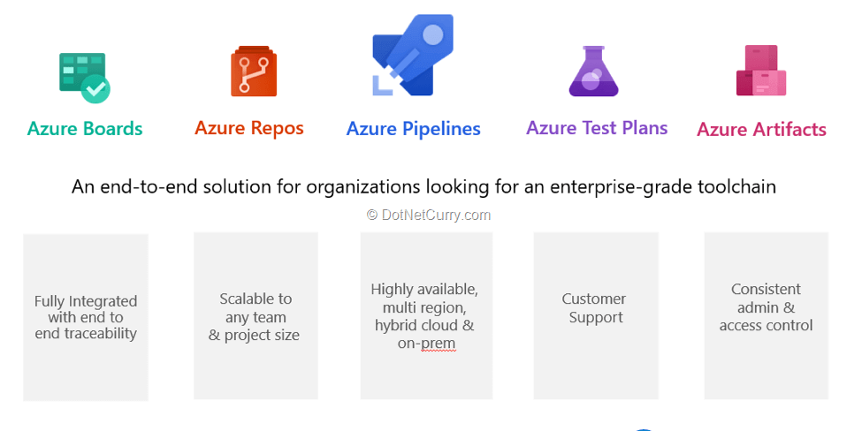
Azure DevOps Services
Azure DevOps provides developer services for allowing teams to plan work, collaborate on code development, and build and deploy applications

Slide 3
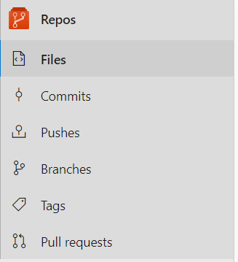
Azure DevOps Services – Azure Repos
Azure Repos is a set of version control tools that you can use to manage your code
Files
In Files, your project solutions will be available in this section. Repositories can create, manage, and import the solutions. Now we’ll see how to upload new solutions in Azure DevOps repos
Commits
In commits section we can manage commits history for your repositories with authors details from branches.
Pushes
Push histories are available in this section from each Pull requests done by the developers.

Slide 4
Azure DevOps Services – Azure Repos
Azure Repos is a set of version control tools that you can use to manage your code
Branches
We can manage multiple branching information in this section. You can create your release branches from master to Dev, QA & Prod environments and also users (employees) branching information available in this section.
Tags
Tags are used to point out specific commits, like giving message tags and data information to branches. You can create your naming conventions to branches by using commit tags.
Pull Requests
Pull requests (PRs) are a way to change, review, and merge code in a Git repository on Azure Repos. PRs can come from branches within the same repository or from branches in forks of the repository. Teams use PRs to review code and give feedback on changes before merging the code into the main branch

Slide 5
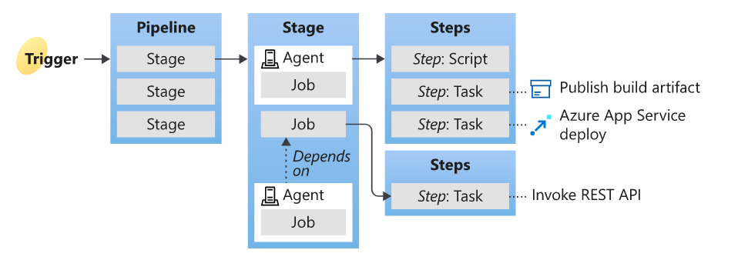
Azure DevOps Services – Pipelines
Azure Pipeline is a cloud service that we can use to build and test our code project automatically. The Azure pipeline has a lot of capabilities such as continuous integration and continuous delivery to regularly and consistently test and builds our code and ship to any target
A trigger tells a Pipeline to run.
A pipeline is made up of one or more stages. A pipeline can deploy to one or more environments.
A stage is a way of organizing jobs in a pipeline and each stage can have one or more jobs.
Each job runs on one agent. A job can also be agentless.
Each agent runs a job that contains one or more steps.
A step can be a task or script and is the smallest building block of a pipeline.
A task is a pre-packaged script that performs an action, such as invoking a REST API or publishing a build artifact.
An artifact is a collection of files or packages published by a run.

Slide 6
Azure DevOps Services – Pipelines
Full Syntax to represent Job
- job: string # name of the job, A-Z, a-z, 0-9, and underscore
displayName: string # friendly name to display in the UI
dependsOn: string | [ string ]
condition: string
strategy:
parallel: # parallel strategy
matrix: # matrix strategy
maxParallel: number # maximum number simultaneous matrix legs to run
# note: `parallel` and `matrix` are mutually exclusive
# you may specify one or the other; including both is an error
# `maxParallel` is only valid with `matrix`
continueOnError: boolean # 'true' if future jobs should run even if this job fails; defaults to 'false'
pool: pool # agent pool
workspace:
clean: outputs | resources | all # what to clean up before the job runs
container: containerReference # container to run this job inside
timeoutInMinutes: number # how long to run the job before automatically cancelling
cancelTimeoutInMinutes: number # how much time to give 'run always even if cancelled tasks' before killing them
variables: { string: string } | [ variable | variableReference ]
steps: [ script | bash | pwsh | powershell | checkout | task | templateReference ]
services: { string: string | container } # container resources to run as a service container
uses: # Any resources (repos or pools) required by this job that are not already referenced
repositories: [ string ] # Repository references to Azure Git repositories
pools: [ string ] # Pool names, typically when using a matrix strategy for the job

Slide 7
Azure DevOps Services – Pipelines
Different types of Jobs
Agent pool jobs run on an agent in an agent pool.
Server jobs run on the Azure DevOps Server.
Container jobs run in a container on an agent in an agent pool. For more information about choosing containers, see Define container jobs.
Deployment group jobs run on machines in a deployment group. These jobs are only available in a release pipeline. For more information about defining groups of target servers for deployment, see Deployment group jobs.
Agent less Jobs run on the infrastructure where Azure DevOps services are running.
The below tasks are supported by agent less jobs as of now.
Delay task
Invoke Azure Function task
Invoke REST API task
Manual Validation task
Publish To Azure Service Bus task
Query Azure Monitor Alerts task
Query Work Items task

Slide 8
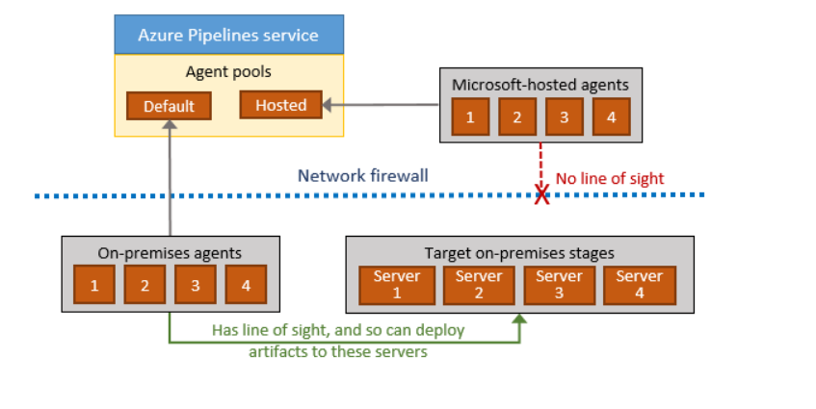
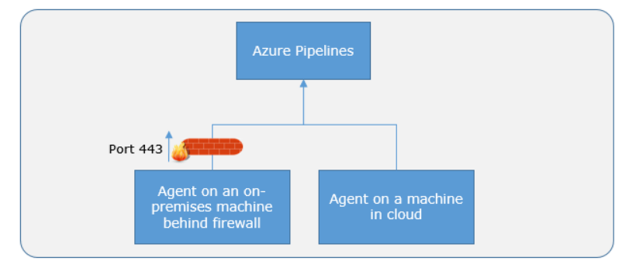
Azure DevOps Services – Pipelines
Communication to deploy to target servers

Slide 9
Azure DevOps Services – Pipelines
Communication to deploy to target servers

Slide 10
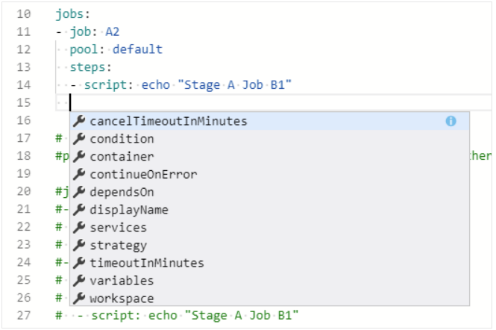
Azure DevOps Services – Pipelines
YAML pipeline Editor
Azure Pipelines provides a YAML pipeline editor that you can use to author and edit your pipelines. The editor provides tools like Intellisense support and a task assistant to provide guidance while you edit a pipeline.
Use keyboard shortcuts
Choose Ctrl+Space for Intellisense support while you're editing the YAML pipeline.

Slide 11
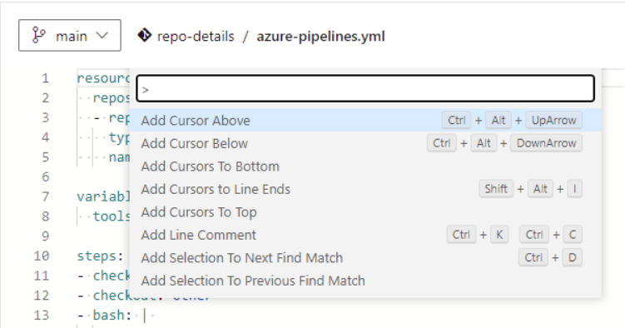
Azure DevOps Services – Pipelines
Use keyboard shortcuts
Choose F1 (Fn+F1 on Mac) to display the command palette and view the available keyboard shortcuts..

Slide 12
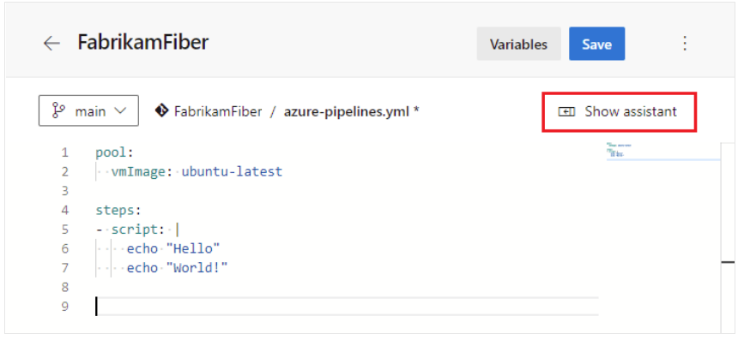
Azure DevOps Services – Pipelines
Use keyboard shortcuts
To display the task assistant, edit your YAML pipeline and choose Show assistant

Slide 13
Thank you…!!!

